Slide 1



GIBU Shipment and Depletion
View in Power BI
Last data refresh:
6/30/2023 5:24:16 AM UTC
Downloaded at:
6/30/2023 5:36:42 AM UTC

Slide 2
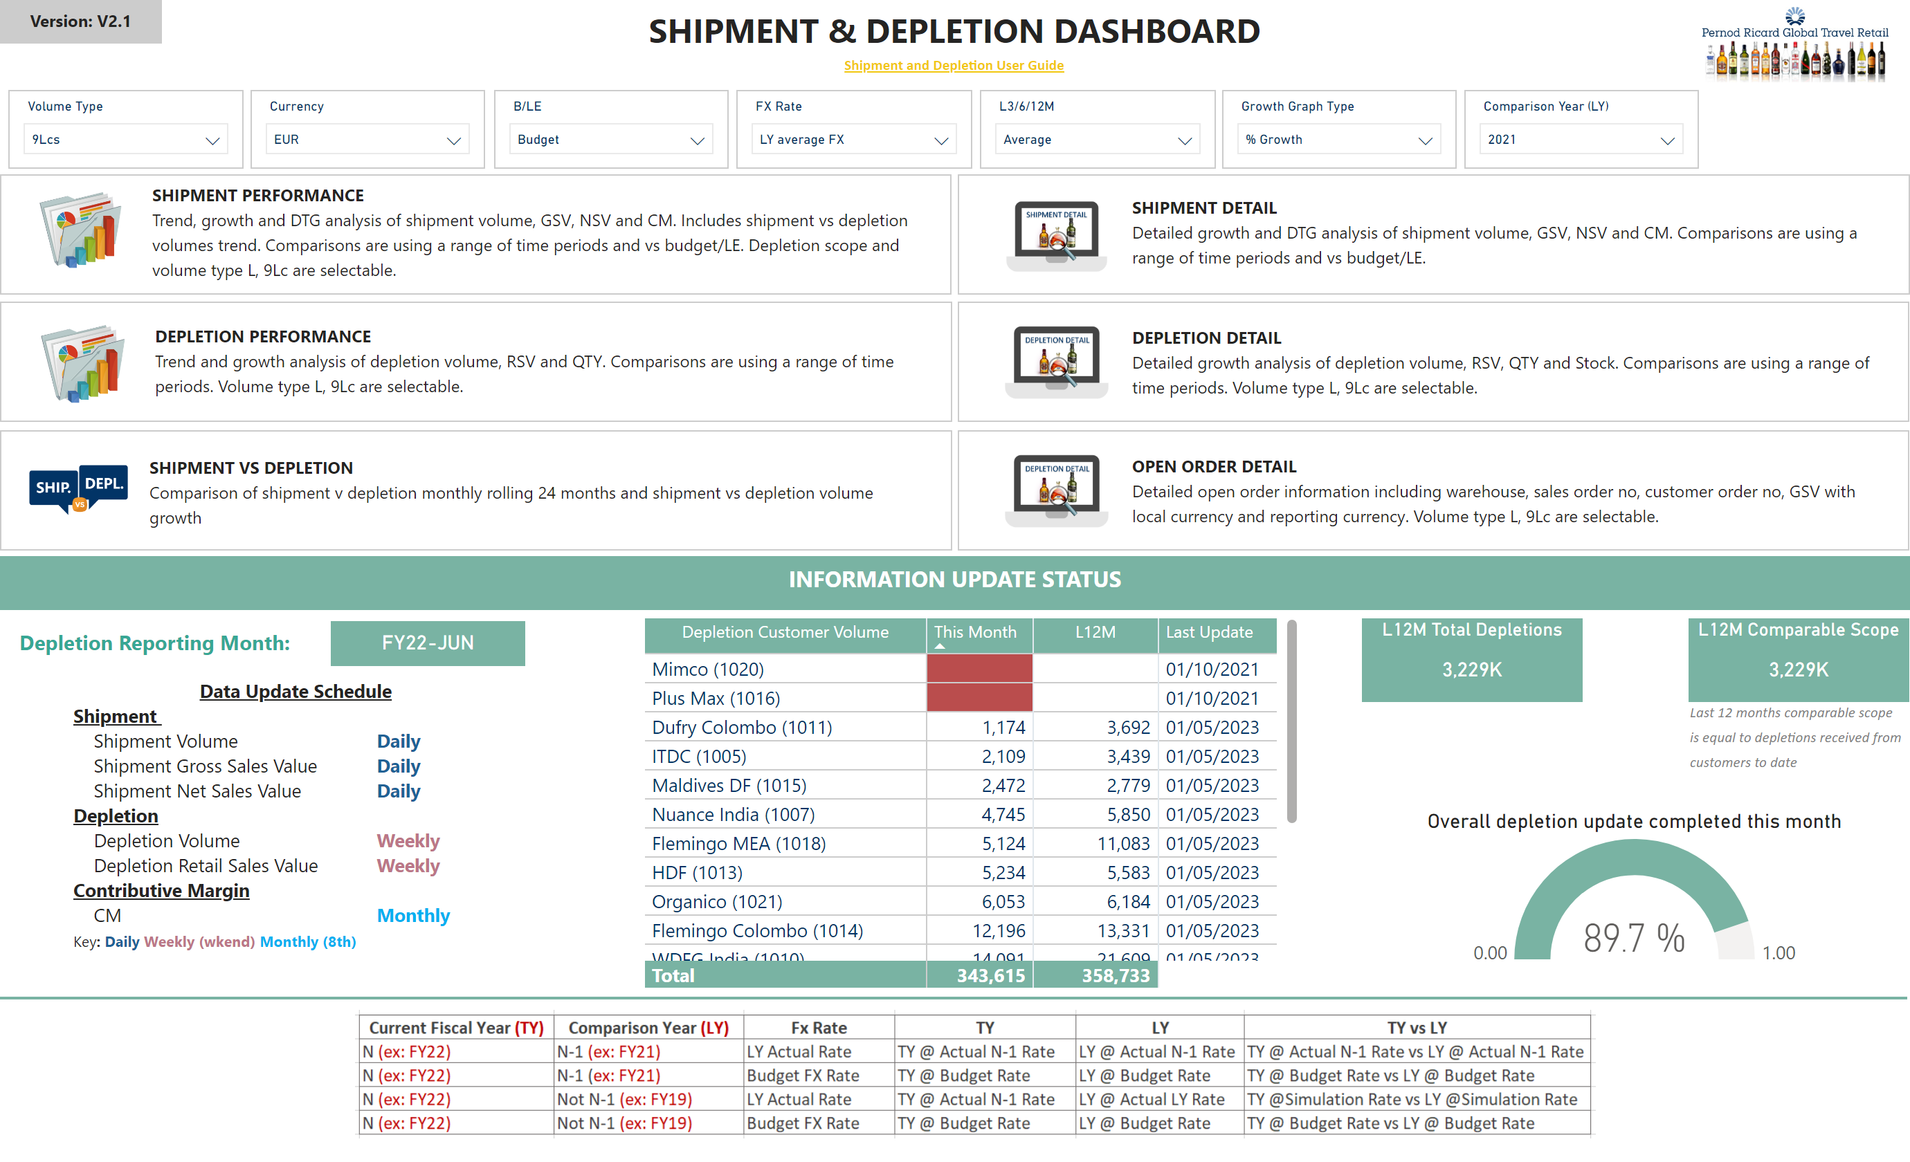
Welcome Page
Notes:
Text Title
No alt text provided
Logo
No alt text provided
basicShape
No alt text provided
basicShape
No alt text provided
basicShape
No alt text provided
L12M Total Depletions
No alt text provided
L12M Comparable Scope
No alt text provided
textbox
No alt text provided
Overall depletion update completed this month
No alt text provided
pivotTable
No alt text provided
textbox
No alt text provided
card
No alt text provided
slicer
No alt text provided
textbox
No alt text provided
textbox
No alt text provided
slicer
No alt text provided
slicer
No alt text provided
slicer
No alt text provided
FX Rate
No alt text provided
L3/6/12M
No alt text provided
slicer
No alt text provided
textbox
No alt text provided
textbox
No alt text provided
slicer
No alt text provided
card
No alt text provided
Icon Depletion Detail
No alt text provided
Shape Depletion Detail
No alt text provided
Text Depletion Detail
No alt text provided
Shape Shipment Performance
No alt text provided
Icon Shipment Performance
No alt text provided
Text Shipment Performance
No alt text provided
Shape Depletion Performance
No alt text provided
Text Depletion Performance
No alt text provided
Icon Depletion Performance
No alt text provided
Text Shipment Detail
No alt text provided
Shape Shipment Detail
No alt text provided
Icon Shipment Detail
No alt text provided
Shape Shipment Performance
No alt text provided
image
No alt text provided
Text Shipment Performance
No alt text provided
Icon OOH Detail
No alt text provided
Text OOH Detail
No alt text provided
Shape OOH Detail
No alt text provided
slicer
No alt text provided
shape
No alt text provided
image
No alt text provided

Slide 3
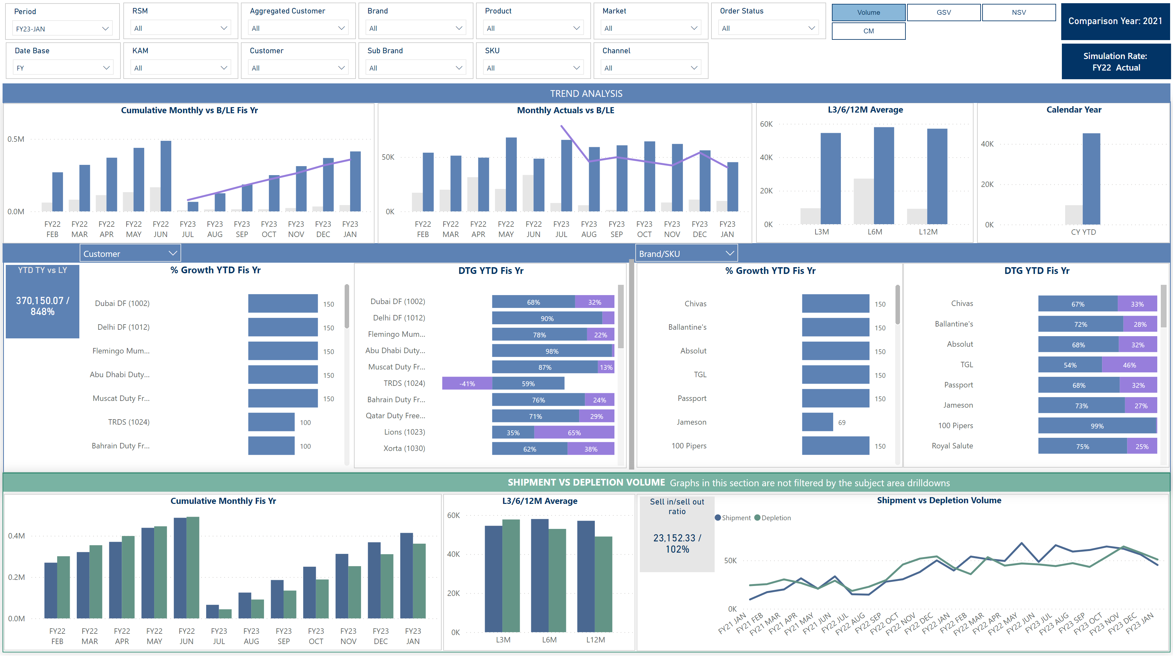
Shipment Performance
Notes:
slicer
No alt text provided
slicer
No alt text provided
slicer
No alt text provided
slicer
No alt text provided
slicer
No alt text provided
slicer
No alt text provided
slicer
No alt text provided
slicer
No alt text provided
slicer
No alt text provided
slicer
No alt text provided
slicer
No alt text provided
card
No alt text provided
textbox
No alt text provided
slicer
No alt text provided
% Growth YTD Fis Yr
No alt text provided
DTG YTD Fis Yr
No alt text provided
% Growth YTD Fis Yr
No alt text provided
DTG YTD Fis Yr
No alt text provided
slicer
No alt text provided
Cumulative Monthly vs B/LE Fis Yr
No alt text provided
Monthly Actuals vs B/LE
No alt text provided
L3/6/12M Average
No alt text provided
Calendar Year
No alt text provided
slicer
No alt text provided
slicer
No alt text provided
textbox
No alt text provided
basicShape
No alt text provided
textbox
No alt text provided
slicer
No alt text provided
card
No alt text provided
card
No alt text provided
card
No alt text provided
ChicletSlicer1448559807354
No alt text provided
slicer
No alt text provided
slicer
No alt text provided
slicer
No alt text provided
slicer
No alt text provided
YTD TY vs LY
No alt text provided
basicShape
No alt text provided
slicer
No alt text provided
slicer
No alt text provided
textbox
No alt text provided
shape
No alt text provided
basicShape
No alt text provided
slicer
No alt text provided
slicer
No alt text provided
card
No alt text provided
Cumulative Monthly Fis Yr
No alt text provided
L3/6/12M Average
No alt text provided
Shipment vs Depletion Volume
No alt text provided
Sell in/sell out ratio
No alt text provided
basicShape
No alt text provided

Slide 4
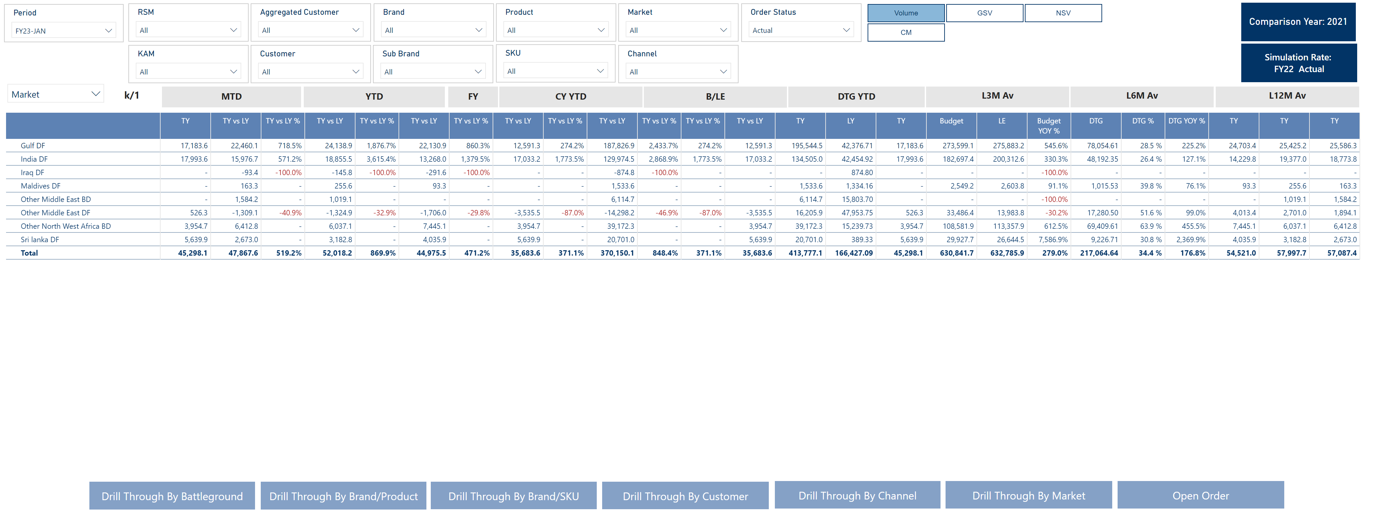
Shipment Detail (1)
Notes:
slicer
No alt text provided
basicShape
No alt text provided
basicShape
No alt text provided
card
No alt text provided
slicer
No alt text provided
slicer
No alt text provided
slicer
No alt text provided
slicer
No alt text provided
slicer
No alt text provided
slicer
No alt text provided
slicer
No alt text provided
slicer
No alt text provided
slicer
No alt text provided
slicer
No alt text provided
slicer
No alt text provided
slicer
No alt text provided
card
No alt text provided
card
No alt text provided
ChicletSlicer1448559807354
No alt text provided
slicer
No alt text provided
slicer
No alt text provided
slicer
No alt text provided
textbox
No alt text provided
textbox
No alt text provided
textbox
No alt text provided
textbox
No alt text provided
textbox
No alt text provided
textbox
No alt text provided
L3M Av
No alt text provided
L3M Av
No alt text provided
L3M Av
No alt text provided
slicer
No alt text provided
card
No alt text provided
slicer
No alt text provided
card
No alt text provided
actionButton
No alt text provided
actionButton
No alt text provided
actionButton
No alt text provided
actionButton
No alt text provided
actionButton
No alt text provided
actionButton
No alt text provided
actionButton
No alt text provided
slicer
No alt text provided
slicer
No alt text provided
financialreportingmatrixD8A502553641450F8EAEB9BA40B2166E
No alt text provided

Slide 5
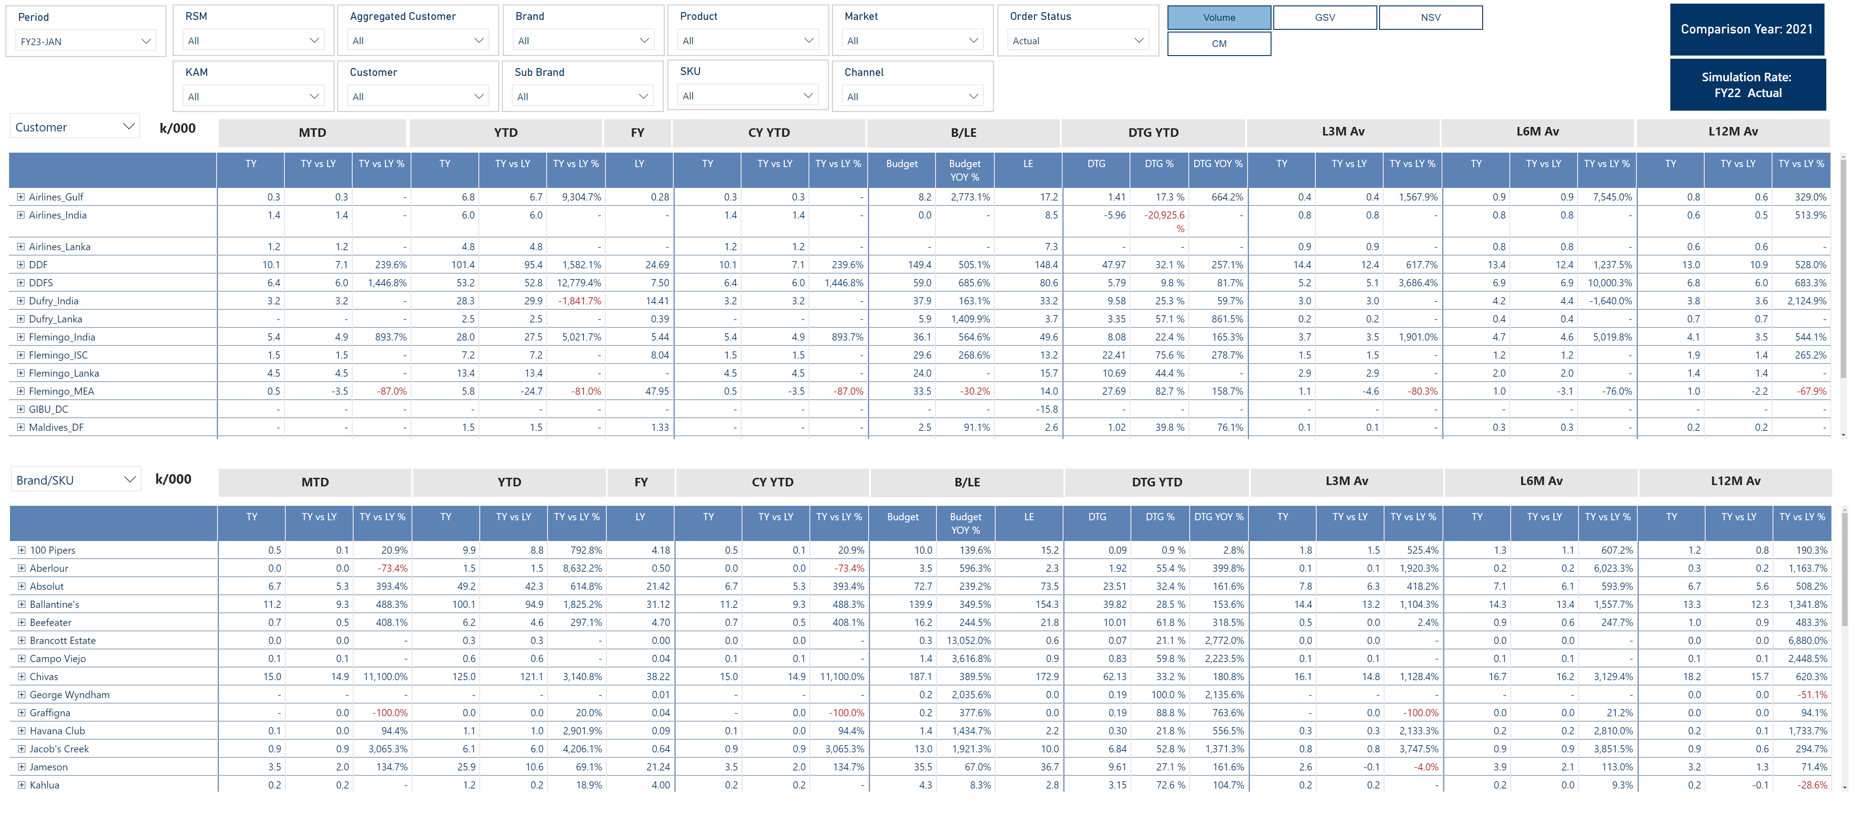
Shipment Detail (2)
Notes:
slicer
No alt text provided
basicShape
No alt text provided
basicShape
No alt text provided
card
No alt text provided
slicer
No alt text provided
slicer
No alt text provided
slicer
No alt text provided
slicer
No alt text provided
slicer
No alt text provided
slicer
No alt text provided
slicer
No alt text provided
slicer
No alt text provided
slicer
No alt text provided
slicer
No alt text provided
slicer
No alt text provided
slicer
No alt text provided
card
No alt text provided
card
No alt text provided
ChicletSlicer1448559807354
No alt text provided
slicer
No alt text provided
slicer
No alt text provided
slicer
No alt text provided
textbox
No alt text provided
textbox
No alt text provided
textbox
No alt text provided
textbox
No alt text provided
textbox
No alt text provided
textbox
No alt text provided
L3M Av
No alt text provided
L3M Av
No alt text provided
L3M Av
No alt text provided
slicer
No alt text provided
card
No alt text provided
slicer
No alt text provided
card
No alt text provided
slicer
No alt text provided
card
No alt text provided
textbox
No alt text provided
textbox
No alt text provided
textbox
No alt text provided
textbox
No alt text provided
textbox
No alt text provided
textbox
No alt text provided
L3M Av
No alt text provided
L3M Av
No alt text provided
L3M Av
No alt text provided
financialreportingmatrixD8A502553641450F8EAEB9BA40B2166E
No alt text provided
slicer
No alt text provided
slicer
No alt text provided
financialreportingmatrixD8A502553641450F8EAEB9BA40B2166E
No alt text provided

Slide 6
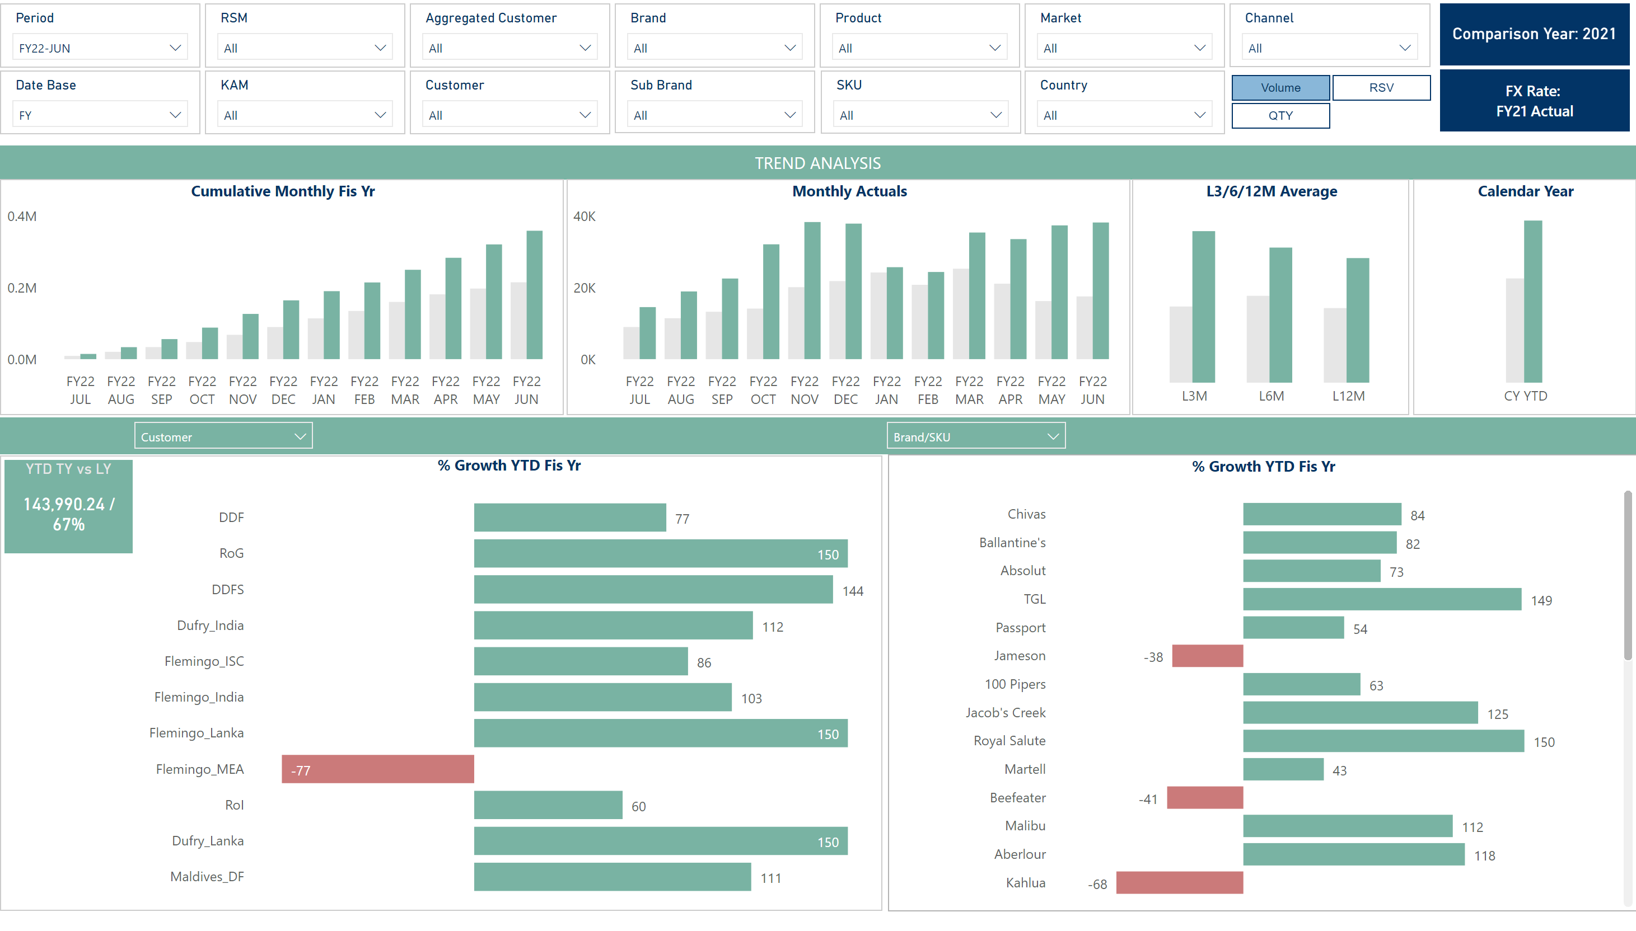
Depletion Performance
Notes:
textbox
No alt text provided
textbox
No alt text provided
slicer
No alt text provided
slicer
No alt text provided
card
No alt text provided
ChicletSlicer1448559807354
No alt text provided
lineChart
No alt text provided
slicer
No alt text provided
slicer
No alt text provided
slicer
No alt text provided
slicer
No alt text provided
slicer
No alt text provided
slicer
No alt text provided
slicer
No alt text provided
slicer
No alt text provided
slicer
No alt text provided
slicer
No alt text provided
slicer
No alt text provided
slicer
No alt text provided
slicer
No alt text provided
card
No alt text provided
slicer
No alt text provided
actionButton
No alt text provided
actionButton
No alt text provided
Country
No alt text provided
YTD TY vs LY
No alt text provided
basicShape
No alt text provided
slicer
No alt text provided
slicer
No alt text provided
slicer
No alt text provided
slicer
No alt text provided
slicer
No alt text provided
card
No alt text provided
card
No alt text provided
% Growth YTD Fis Yr
No alt text provided
% Growth YTD Fis Yr
No alt text provided
Monthly Actuals
No alt text provided
Cumulative Monthly Fis Yr
No alt text provided
L3/6/12M Average
No alt text provided
Calendar Year
No alt text provided
slicer
No alt text provided

Slide 7
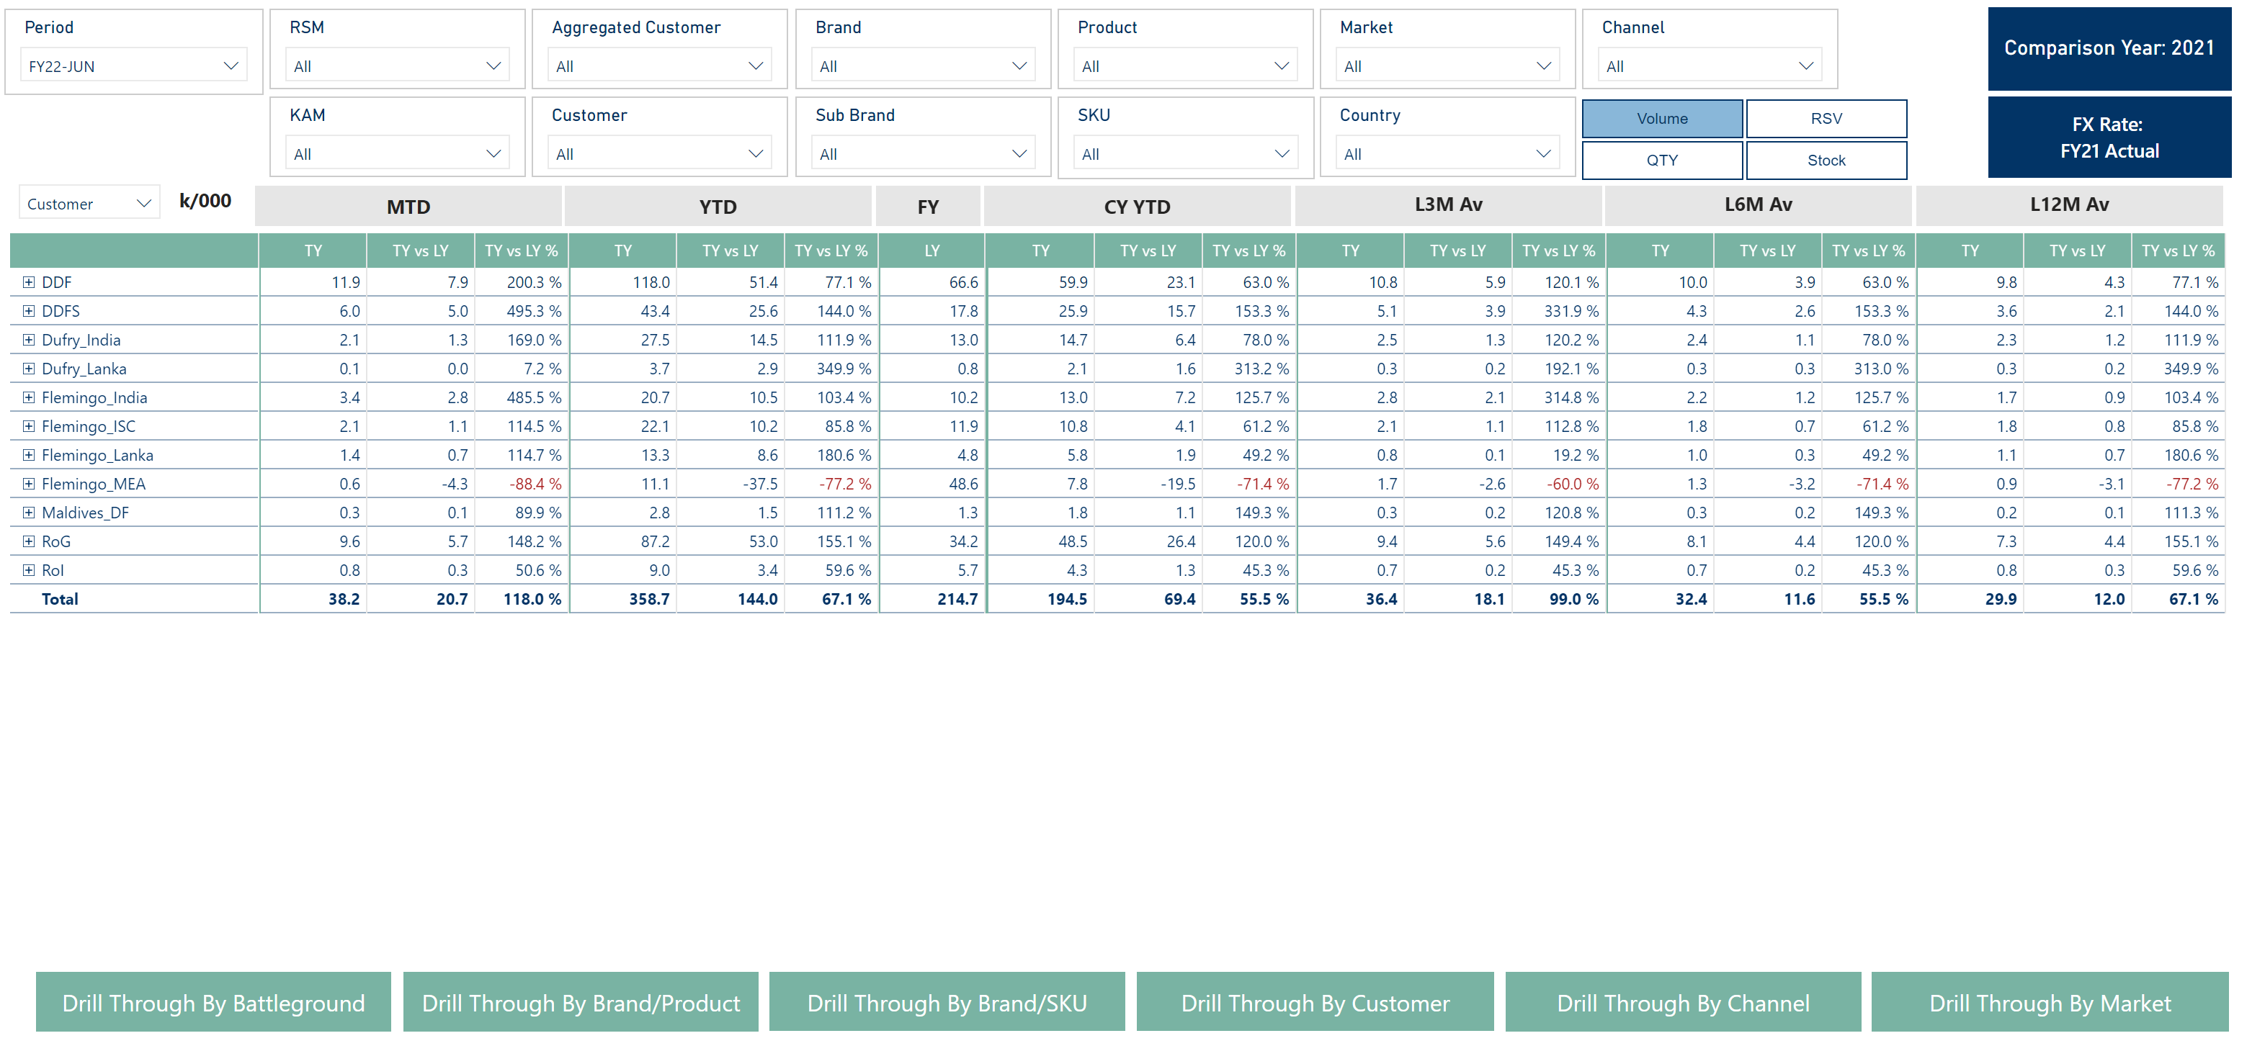
Depletion Detail (1)
Notes:
slicer
No alt text provided
card
No alt text provided
slicer
No alt text provided
slicer
No alt text provided
slicer
No alt text provided
slicer
No alt text provided
slicer
No alt text provided
slicer
No alt text provided
slicer
No alt text provided
slicer
No alt text provided
slicer
No alt text provided
basicShape
No alt text provided
slicer
No alt text provided
slicer
No alt text provided
card
No alt text provided
ChicletSlicer1448559807354
No alt text provided
slicer
No alt text provided
slicer
No alt text provided
slicer
No alt text provided
slicer
No alt text provided
slicer
No alt text provided
textbox
No alt text provided
textbox
No alt text provided
textbox
No alt text provided
textbox
No alt text provided
L3M Av
No alt text provided
L3M Av
No alt text provided
L3M Av
No alt text provided
slicer
No alt text provided
card
No alt text provided
card
No alt text provided
actionButton
No alt text provided
actionButton
No alt text provided
actionButton
No alt text provided
actionButton
No alt text provided
actionButton
No alt text provided
actionButton
No alt text provided
financialreportingmatrixD8A502553641450F8EAEB9BA40B2166E
No alt text provided
slicer
No alt text provided
slicer
No alt text provided
slicer
No alt text provided

Slide 8
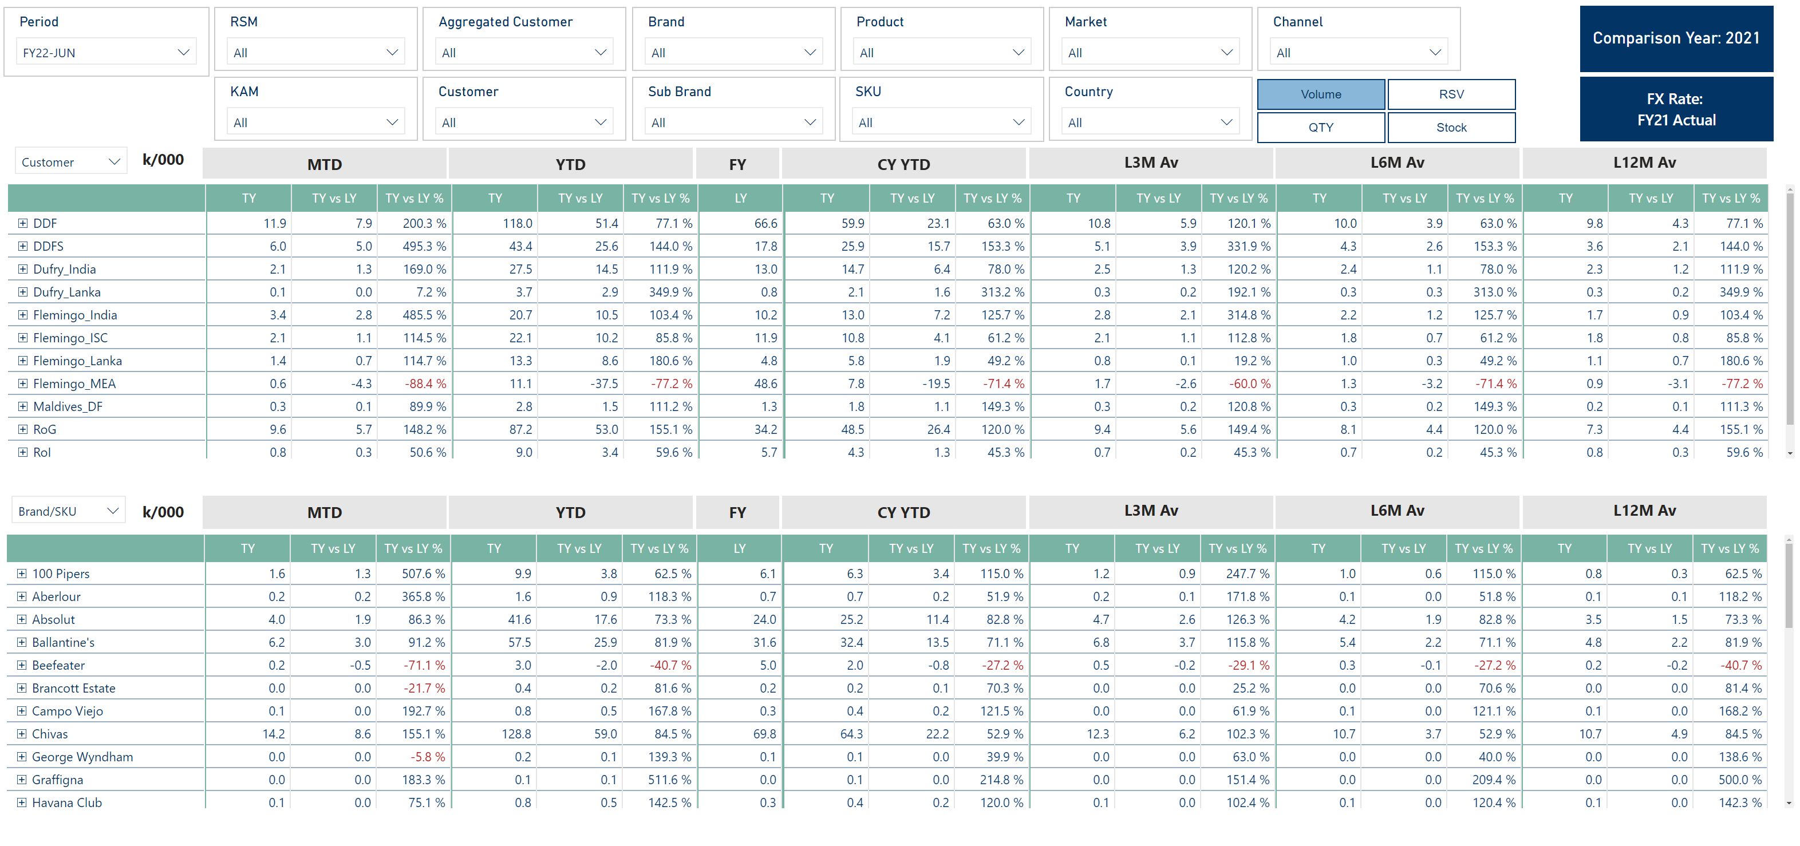
Depletion Detail (2)
Notes:
slicer
No alt text provided
card
No alt text provided
slicer
No alt text provided
slicer
No alt text provided
slicer
No alt text provided
slicer
No alt text provided
slicer
No alt text provided
slicer
No alt text provided
slicer
No alt text provided
slicer
No alt text provided
slicer
No alt text provided
basicShape
No alt text provided
slicer
No alt text provided
slicer
No alt text provided
card
No alt text provided
ChicletSlicer1448559807354
No alt text provided
slicer
No alt text provided
slicer
No alt text provided
slicer
No alt text provided
slicer
No alt text provided
textbox
No alt text provided
textbox
No alt text provided
textbox
No alt text provided
textbox
No alt text provided
L3M Av
No alt text provided
L3M Av
No alt text provided
L3M Av
No alt text provided
slicer
No alt text provided
card
No alt text provided
card
No alt text provided
card
No alt text provided
slicer
No alt text provided
textbox
No alt text provided
textbox
No alt text provided
textbox
No alt text provided
textbox
No alt text provided
L3M Av
No alt text provided
L3M Av
No alt text provided
L3M Av
No alt text provided
financialreportingmatrixD8A502553641450F8EAEB9BA40B2166E
No alt text provided
financialreportingmatrixD8A502553641450F8EAEB9BA40B2166E
No alt text provided
slicer
No alt text provided
slicer
No alt text provided
slicer
No alt text provided

Slide 9
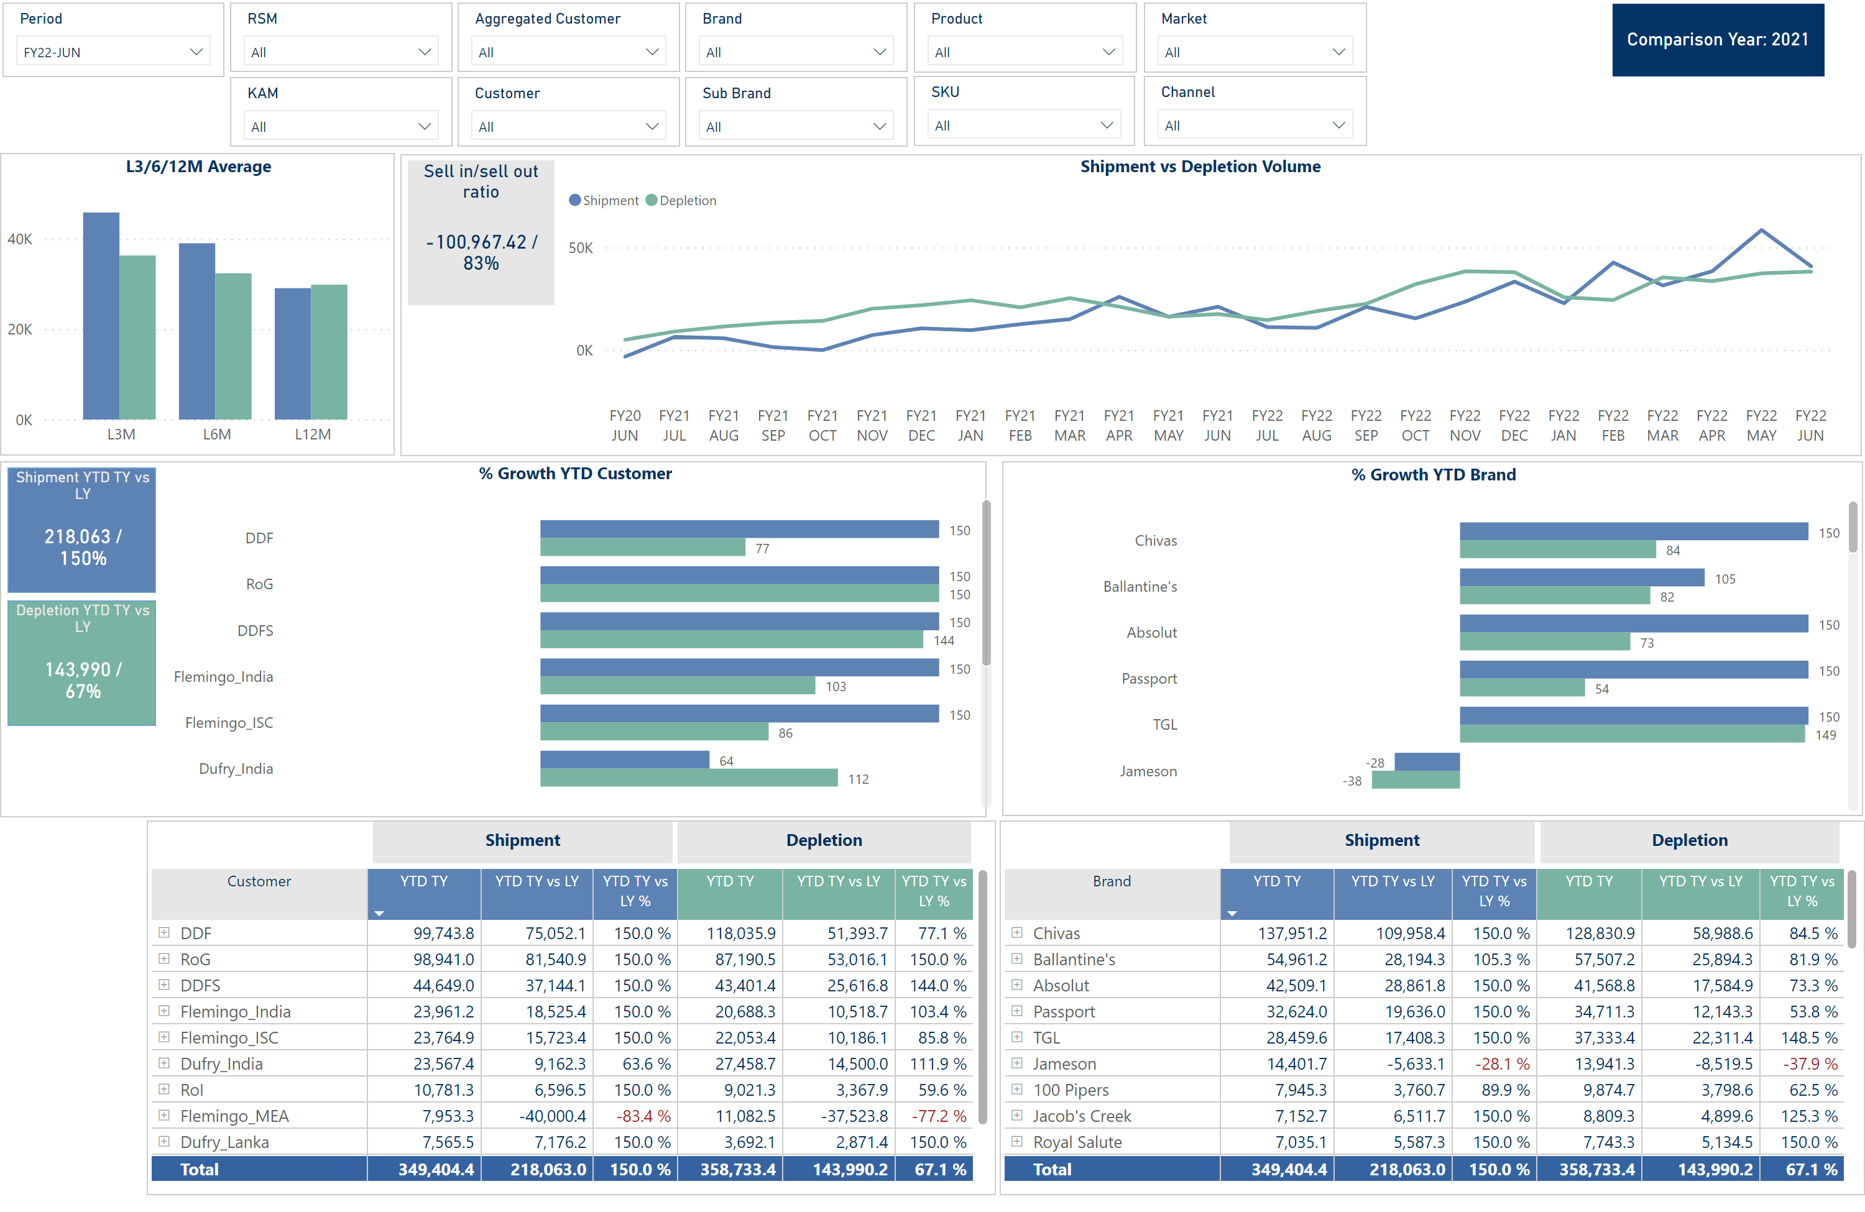
Shipment vs Depletion Volume Detail
Notes:
slicer
No alt text provided
slicer
No alt text provided
slicer
No alt text provided
slicer
No alt text provided
slicer
No alt text provided
slicer
No alt text provided
slicer
No alt text provided
slicer
No alt text provided
slicer
No alt text provided
slicer
No alt text provided
slicer
No alt text provided
slicer
No alt text provided
L3/6/12M Average
No alt text provided
slicer
No alt text provided
slicer
No alt text provided
% Growth YTD Customer
No alt text provided
Customer Growth YTD
No alt text provided
textbox
No alt text provided
textbox
No alt text provided
basicShape
No alt text provided
Sell in/sell out ratio
No alt text provided
Shipment YTD TY vs LY
No alt text provided
Depletion YTD TY vs LY
No alt text provided
basicShape
No alt text provided
basicShape
No alt text provided
slicer
No alt text provided
slicer
No alt text provided
% Growth YTD Brand
No alt text provided
Shipment vs Depletion Volume
No alt text provided
Customer Growth YTD
No alt text provided
textbox
No alt text provided
textbox
No alt text provided
basicShape
No alt text provided
slicer
No alt text provided
slicer
No alt text provided
card
No alt text provided
slicer
No alt text provided
slicer
No alt text provided
slicer
No alt text provided
slicer
No alt text provided

Slide 10
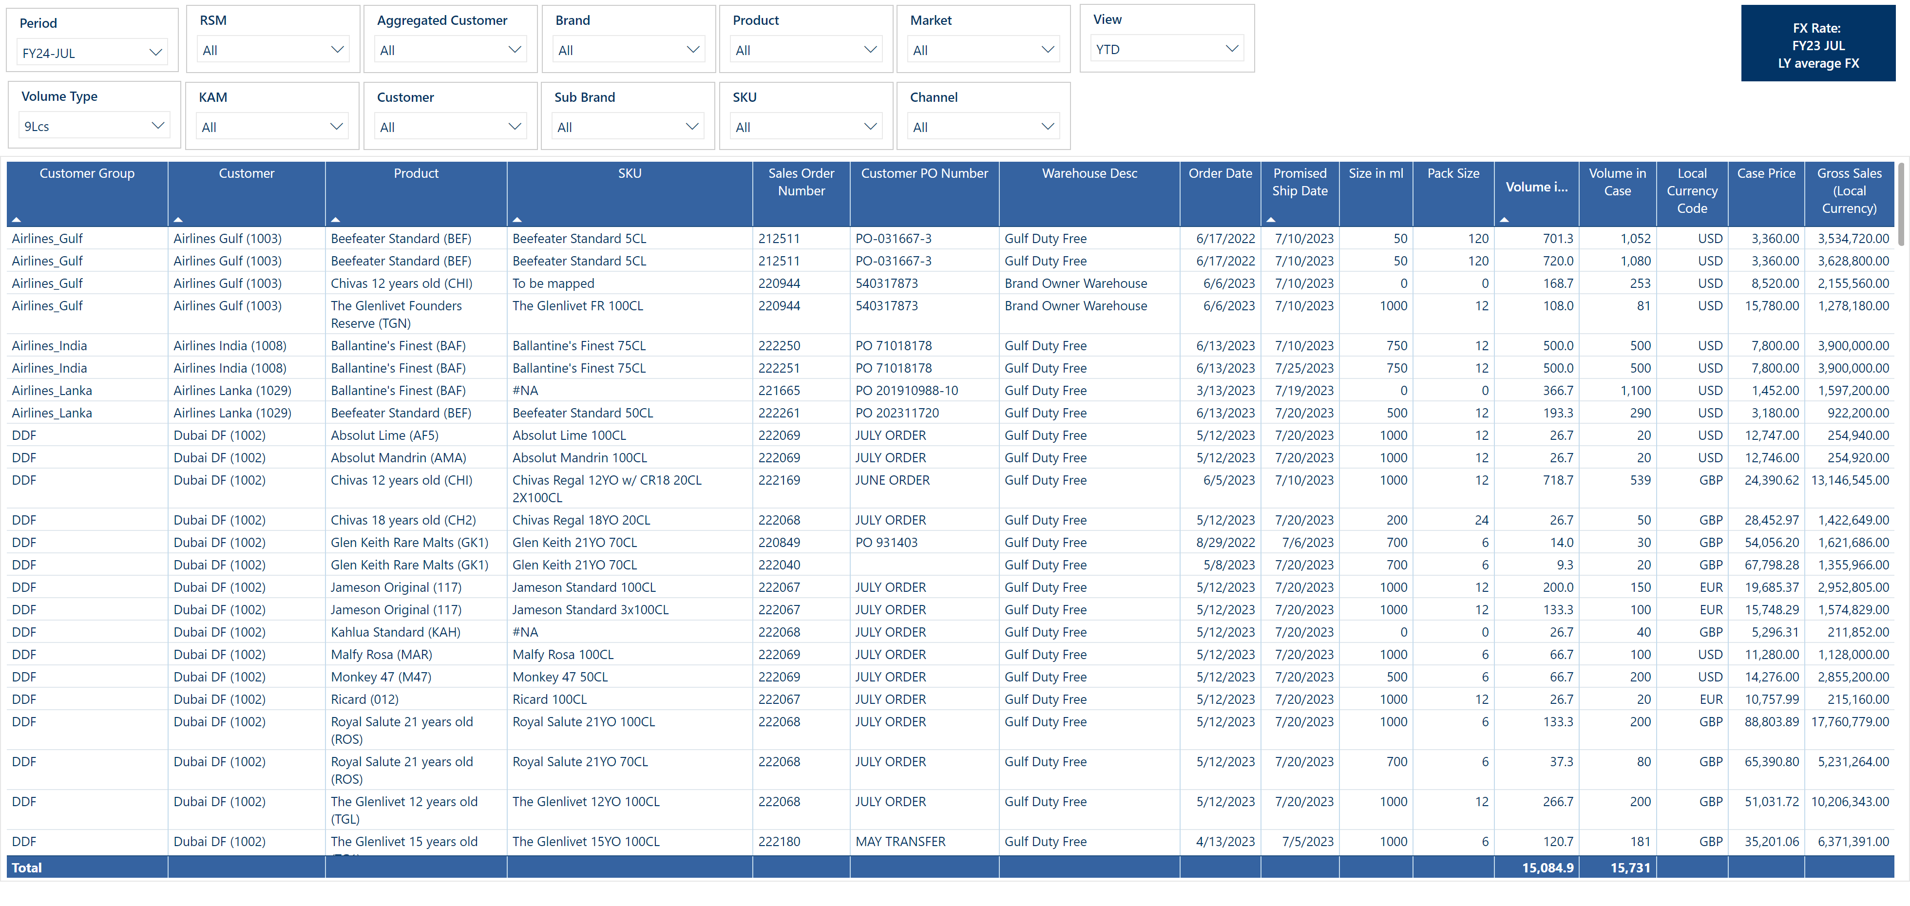
Open Order Detail
Notes:
basicShape
No alt text provided
basicShape
No alt text provided
slicer
No alt text provided
slicer
No alt text provided
slicer
No alt text provided
slicer
No alt text provided
slicer
No alt text provided
shape
No alt text provided
slicer
No alt text provided
slicer
No alt text provided
slicer
No alt text provided
slicer
No alt text provided
slicer
No alt text provided
slicer
No alt text provided
slicer
No alt text provided
slicer
No alt text provided
slicer
No alt text provided
Volume Type
No alt text provided
slicer
No alt text provided
card
No alt text provided
basicShape
No alt text provided
card
No alt text provided
slicer
No alt text provided
card
No alt text provided
slicer
No alt text provided
card
No alt text provided
tableEx
No alt text provided

